Slide 1
Music Genre Classification CS6316 Final Project
Yuchi Tian
yt8mn@virginia.edu

Slide 2
Motivation
Music genre classification is common and significant task in MIR (Music Information Retrieval) and plays an important roles in MER(Music Emotion Recognition).
Music genre automatic classification has been applied by many commercial music websites such as AMG or Last.fm for music recommendation.

Slide 3
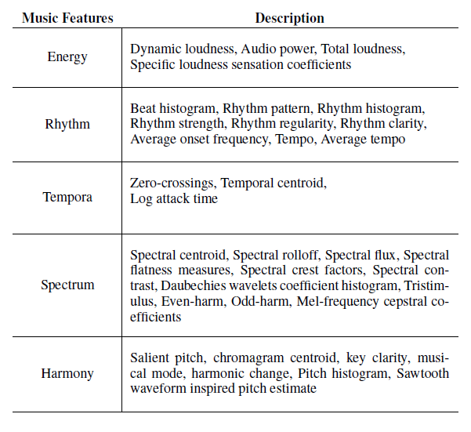
Background

Slide 4
Related Work
music genre classification algorithms | Reference
K-Nearest Neighbor (KNN) | [1,2]
Gaussian Mixture Models (GMM) | [1]
Hidden Markov Model (HMM) | [3,4]
Linear Discriminant Analysis (LDA) | [5,6]
Support Vector Machines (SVM) | [5,7,8,9]
Fuzzy Clustering | [7]
Combination of Classifiers | [10]
Sparse Representation-based Classification | [11]

Slide 5
Claim / Target Task

Slide 6
Proposed Solution
For 1-nn, Distance = 1/Length(longest common subsequence)

Slide 7
Implementation

Slide 8
Implementation

Slide 9
Implementation

Slide 10
Dataset: GTZAN
This dataset was used for the well known paper in genre classification " Musical genre classification of audio signals " by G. Tzanetakis and P. Cook in IEEE Transactions on Audio and Speech Processing 2002.
The files were collected in 2000-2001 from a variety of sources including personal CDs, radio, microphone recordings, in order to represent a variety of recording conditions.
The dataset consists of 1000 audio tracks each 30 seconds long. It contains 10 genres, each represented by 100 tracks. The tracks are all 22050Hz Mono 16-bit audio files in .wav format.

Slide 11
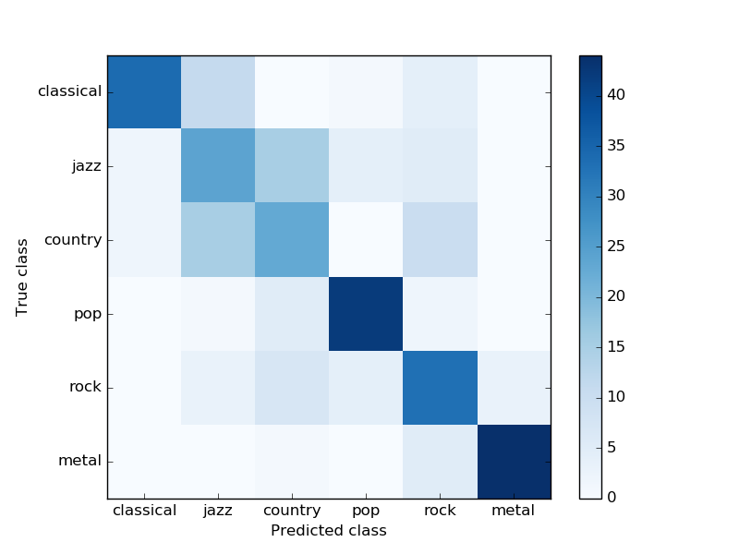
Experimental Results
Feature Group 1
kernel = ‘poly’
C = 2
gamma = 2
degree = 2
classification accuracy: 0.67
[[34 11 0 1 4 0]
[ 2 24 15 4 5 0]
[ 2 15 23 0 10 0]
[ 0 1 5 42 2 0]
[ 0 3 7 4 33 3]
[ 0 0 1 0 5 44]]

Slide 12
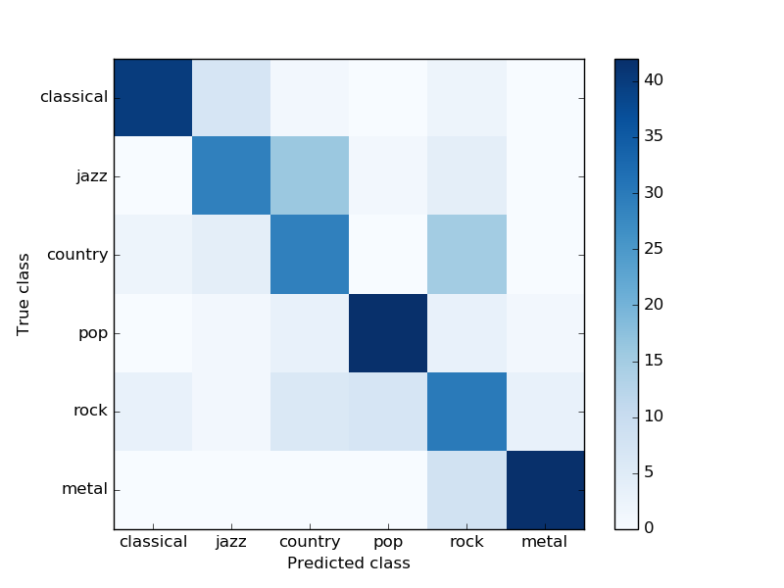
Experimental Results
Feature Group 2
kernel = 'rbf'
C= 4
gamma = 0.125
classification accuracy: 0.71
[[40 7 1 0 2 0 ]
[ 0 29 16 1 4 0 ]
[ 2 4 29 0 15 0 ]
[ 0 1 3 42 3 1 ]
[ 3 1 6 7 30 3 ]
[ 0 0 0 0 8 42]]

Slide 13
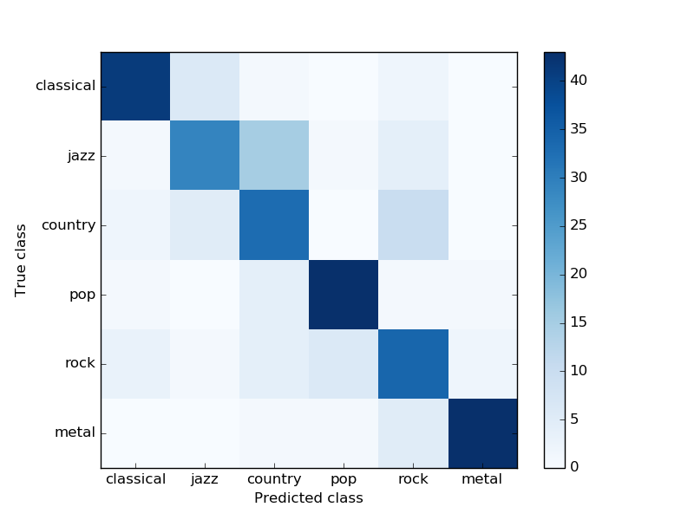
Experimental Results
Selected and Combined features
kernel = 'rbf'
C= 1
gamma = 0.125
classification accuracy: 0.74
[[41 6 1 0 2 0]
[ 1 29 15 1 4 0]
[ 2 5 33 0 10 0]
[ 1 0 4 43 1 1]
[ 3 1 4 6 34 2]
[ 0 0 1 1 5 43]]

Slide 14

Experimental Results
Combined features with Chord
kernel = 'rbf'
C= 1
gamma = 0.125
classification accuracy: 0.76
[[41 6 1 0 2 0]
[ 1 35 9 1 4 0]
[ 2 6 32 0 10 0]
[ 1 1 3 43 1 1]
[ 3 1 4 6 34 2]
[ 0 0 1 1 5 43]]

Slide 15
Conclusion and Future Work
Conclusion
Chord sequence helps classify jazz songs from country songs.
Chord sequence improves the classification accuracy.
Future Work
By improving the chord recognition
By use other mid-level feature such as instrument
By using k-nn instead of 1-nn
By replacing length of longest common subsequence with other feature as distance.

Slide 16
References
[1] Tzanetakis, G. & Cook, P. 2002. Musical genre classification of audio signals. IEEE Trans. Speech Audio Process. 10, 5, 293302. http://marsyas.sness.net/.
[2] Elias Pampalk, Arthur Flexer, & Gerhard Widmer. (2005).Improvements of Audio-based Music Similarity and Genre Classification
[3] Cheng, H.-T., Yang, Y.-H., Lin, Y.-C., Liao, I.-B., & Chen, H.-H. 2008. Automatic chord recognition for music classification and retrieval. In Proceedings of the IEEE International Conference on Multimedia and Expo. 15051508.
[4] Unsupervised Classification of Music Genre Using Hidden Markov Model
[5] A Comparative Study on Content-Based Music Genre Classification

Slide 17
References
[6] K. West, S. Cox, Finding an optimal segmentationfor audio genre classification, in Proceedings of the 6th Int. Symposium on Music Information Retrieval, London, UK, 2005.
[7] Soujanya Poria1, Alexander Gelbukh & Amir Hussain. Music Genre Classification: A Semi-supervised Approach
[8] N. Scaringella, G. Zoia, On the modeling of time information for automatic genre recognition systems in audio signals, in Proceedings of the 6th Int. Symposium on Music Information Retrieval, London, UK, 2005.
[9] N. Scaringella, D. Mlynek, A mixture of support vector machines for audio classification. Music Information Retrieval Evaluation exchange (MIREX) website.
[10] Automatic Music Genre Classification Using Ensemble of Classifiers

Slide 18
References
[11] Yannis Panagakis, Constantine Kotropoulos, & Gonzalo R. Arce (2009) Music Genre Classification via Sparse Representations of Auditory Temporal Modulations.

